Slide 1



TeCare
The Secure Frontier of Healthcare
A Strategic Journey of a Hospital Manager in Organizing Assets and Defending the Digital Sanctity of Patient Lives
Get Started

Slide 2



Good Morning everyone
I’m Dr.Ahmed
As the director, I envisioned a 'Smart Hospital' where EMR and IoT devices save lives every second. But I also knew that being
'connected' means being 'targeted'.
I couldn't risk patient safety or data
privacy. So, I challenged my team
to find our weaknesses and build
a digital fortress. This is how we
secured our vision.
The Manager of TeCare Hospital

Slide 3

Chapter 1:
Mapping the Kingdom (Assets & Roles)
01
Chapter 2:
The Storm - Simulating the Attacks
02
Chapter 3:
The Shield - Defense & Design
03
Conclusion:
A Safer Future
04

Slide 4

Dr.Ahmed is very confused and doesn’t know how or from where to start ??!
So, He needs Some HELP from Cyber security engineers

Slide 5


01
Mapping the Kingdom (Assets & Roles)
I will take you through the first phase of our investigation. To build a defense, we first had to understand the landscape. I will be presenting our analysis of the hospital's Departments and Roles, followed by our detailed Identification of Digital Assets. We need to see what we are protecting before we can decide how to protect it
Hello Dr.Ahmed
I’m ENG.Basmala
Cybersecurity Risk Analyst
Building on that foundation, I will move to the next critical step. It’s not enough to know the assets; we must know who is accountable for them and how dangerous a threat to them would be. I will present the Asset Ownership Mapping across departments and, most importantly, our Risk and Criticality Assessment. This is where we identify our 'Crown Jewels' and prioritize our defense based on the highest risks to patient safety
Hello Dr.Ahmed
I’m ENG.Hasnaa
Information Security Auditor

Slide 6
01
Mapping the Kingdom (Assets & Roles)
Introduction to
Hospital Departments & Roles Treatments
Human Resources (HR):
Manages employee recruitment and personal data.
IT & Cybersecurity:
Responsible for infrastructure, networks, and security.
Medical Records (EMR):
Stores and manages patient medical data.
Emergency & Labs:
Manage critical patient care, emergency services, and lab results.
Finance & App Team:
Handle billing, payments, and staff-patient digital interactions.

Slide 7
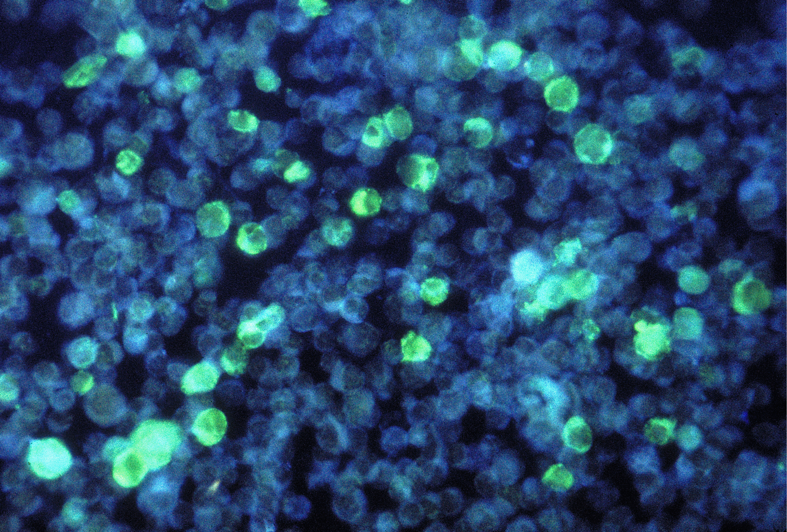

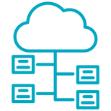



01
Mapping the Kingdom (Assets & Roles)
Digital Asset Identification
Core Servers:
EMR Server (Patient records), PACS Server (Radiology), and Backup Servers.
Endpoints & Apps:
Doctors’ Laptops and Mobile/Web Applications.
Medical Devices:
IoT Patient Monitors (Vitals) and Ambulance GPS.
Infrastructure:
Hospital WiFi and Biometric Access Systems for physical security.

Slide 8


01
Mapping the Kingdom (Assets & Roles)
Asset Ownership Mapping
Who Owns the Risk?
EMR Dept
Responsible for EMR Database and PACS Server.
IT & Cybersecurity
Owns Active Directory, Backups, and Firewalls

Slide 9
01
Mapping the Kingdom (Assets & Roles)
Asset Ownership Mapping
Who Owns the Risk?
Emergency & Labs
Manage IoT Monitors, Ambulance GPS, and Lab Machines.
HR & Finance
Control Employee data, PCs, POS Systems, and Billing.

Slide 10

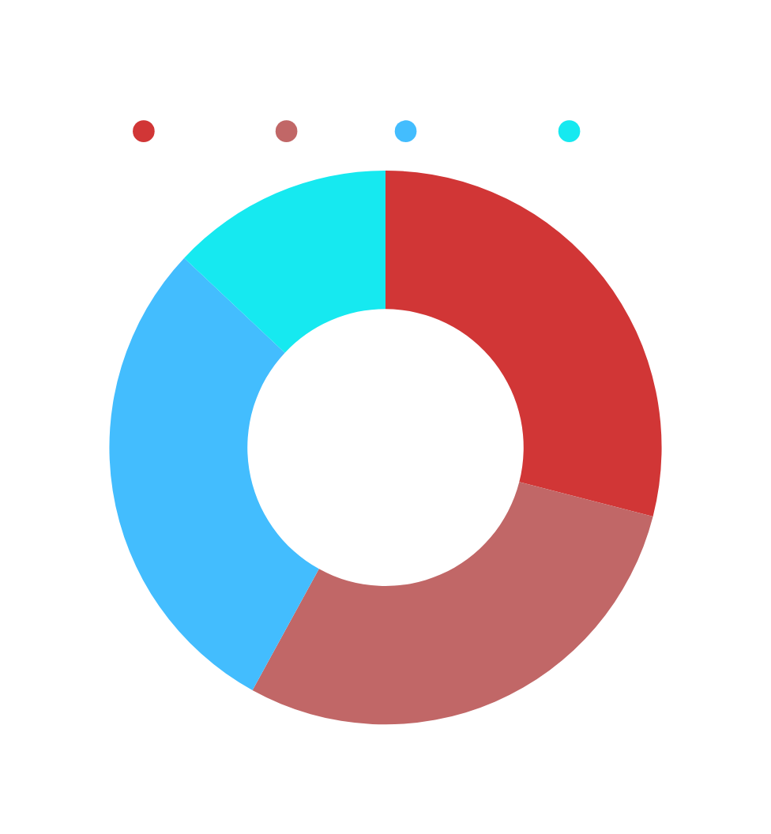
01
Mapping the Kingdom (Assets & Roles)
Risk & Criticality Assessment
CRITICAL
HIGH
MEDIUM
LOW
EMR Database
IoT Patient Monitors
Doctor Emails
Finance POS System
HR PCs
Hospital Website
Guest WiFi Network

Slide 11

Dr. Ahmed ( With a woried voice ):
Wait... stop for a second!!
Looking at this chart, I am honestly shocked. I knew we had risks, but seeing that our EMR Database and IoT Patient Monitors are labeled as 'Critical' is terrifying. This means our patients' lives and their most private data are literally hanging by a thread. We aren't just looking at 'IT issues'; we are looking at potential life-or-death scenarios

Slide 12

Dr. Ahmed :
I found a very good idea!!
I am hiring you not just as analysts, but as Professional Pen-testers. I want you to
attack us. Break into our systems, find
every hidden vulnerability, and show me
the truth. If we want to build a real
fortress, we must think like the enemy first

Slide 13


02
The Storm - Simulating the Attacks
Penetration
Testers
Hello Dr.Ahmed
I’m ENG.Doha
Hello Dr.Ahmed
I’m ENG.Adel
I took the challenge to test our 'Digital Gates'. I focused on the Staff Dashboard and Patient Database. By using Spear Phishing and SQL Injection, I managed to break through the login screens and reach our most sensitive records. I’ll show you exactly how I did it in the next few slides
As for the 'Invisible Infrastructure', I targeted the IT Dashboard and IoT devices. Using ARP Spoofing and Brute Force, I intercepted live medical data and took full control of the monitoring system. Let’s look at the technical breakdown of these network attacks

Slide 14
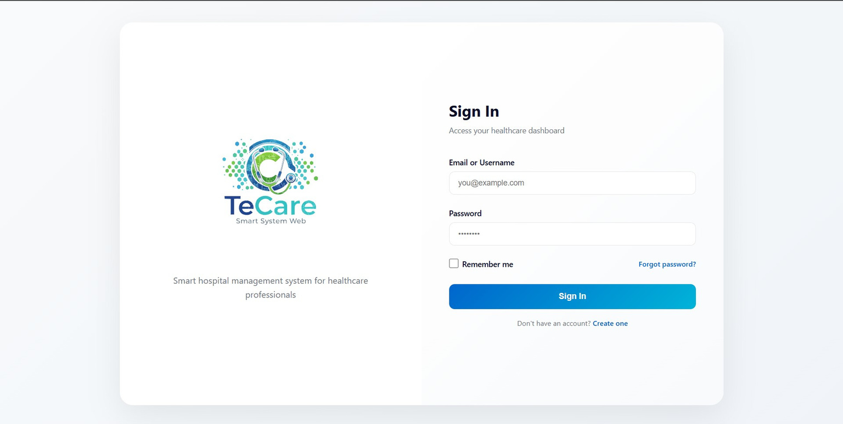
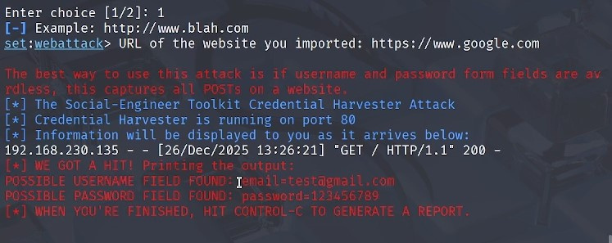
02
The Storm - Simulating the Attacks
The Human Entry Point
Spear Phishing Attack
Attack Vector:
Sending a "weaponized" email to an HR employee containing a malicious link.
The Goal:
Stealing user credentials to gain an initial foothold into the internal network.
Impact:
Upon clicking the link, we gained unauthorized access that allowed us to reach the Doctors' Dashboard.

Slide 15
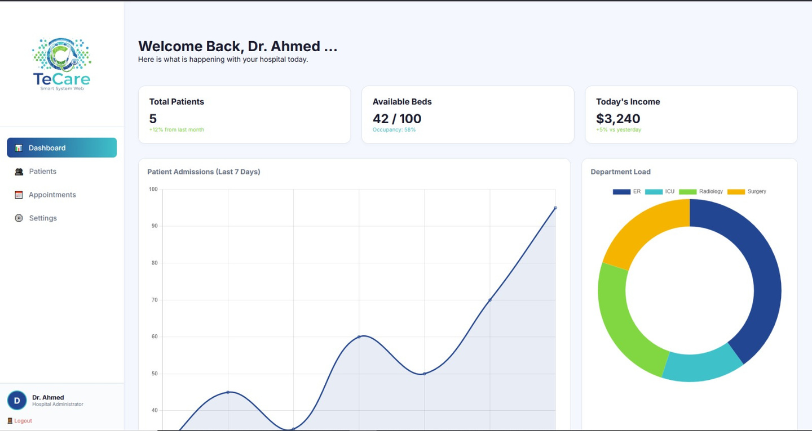
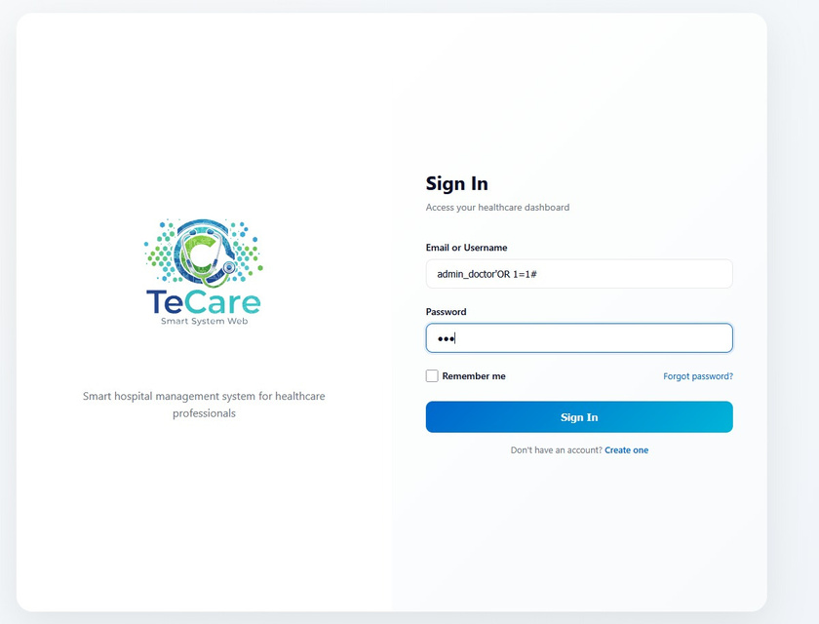
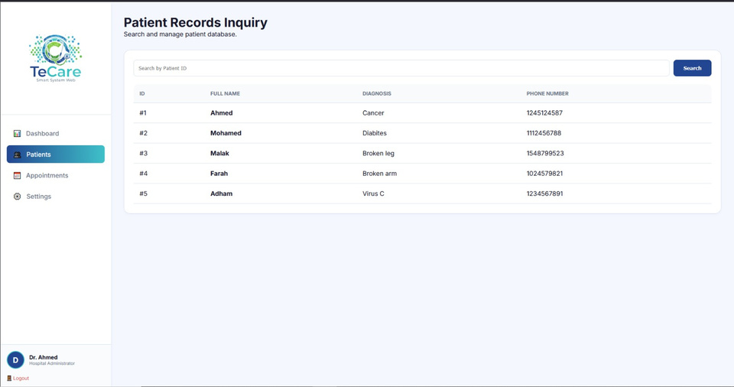
02
The Storm - Simulating the Attacks
Vulnerability:
Exploiting an input validation flaw in the Patient Dashboard login form.
Execution:
Injecting the malicious command ' OR 1=1 -- into the username field to manipulate the database query.
Result:
The system evaluated the statement as "True," allowing us to bypass the password check and gain full access to sensitive records (Names, Diagnosis, and Medications).
Breaking the Database
SQL Injection Attack

Slide 16
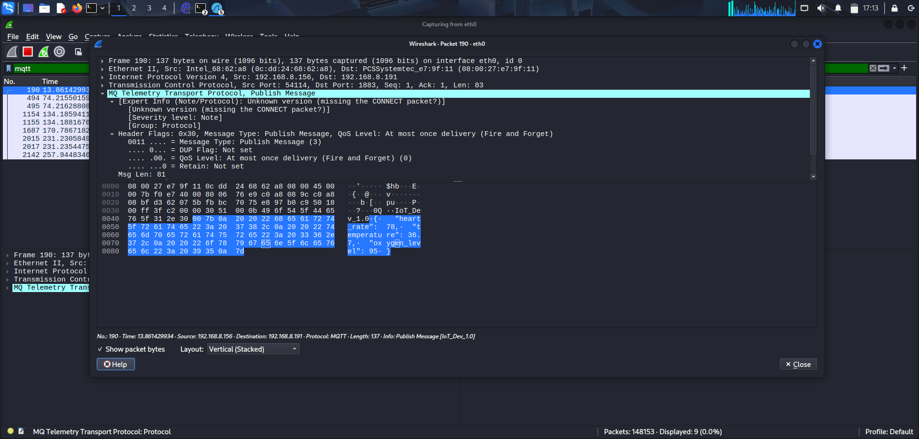
02
The Storm - Simulating the Attacks
Intercepting the Pulse
ARP Spoofing Attack
Vulnerability:
• Lack of secure communication between the IoT device and the Broker.
• Reliance on the local network without protection against ARP Spoofing
Execution:
• Launching an ARP Spoofing attack using Ettercap to impersonate both the IoT device and the Broker.
• Redirecting network traffic through the attacker’s machine.
Result:
• Successful interception of data exchanged between the IoT device and the Broker (sensor readings, commands, device status).
• Demonstrates how ARP Spoofing can enable MITM attacks and compromise data confidentiality and integrity in IoT environments.

Slide 17
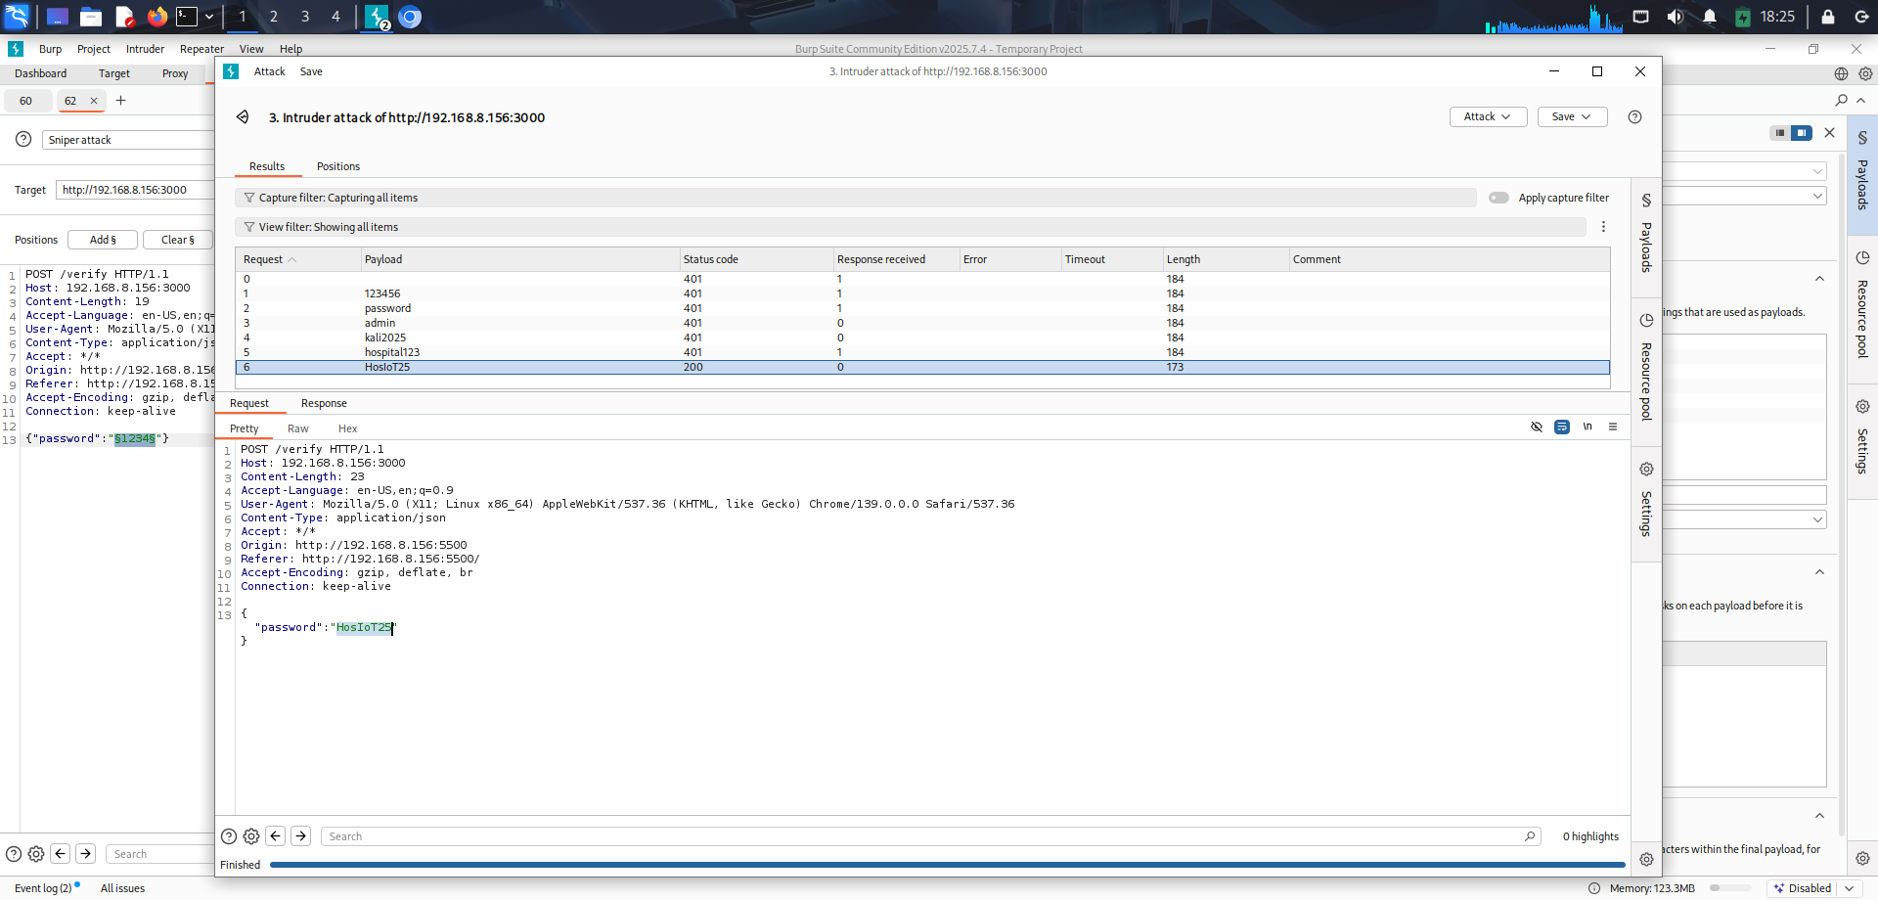
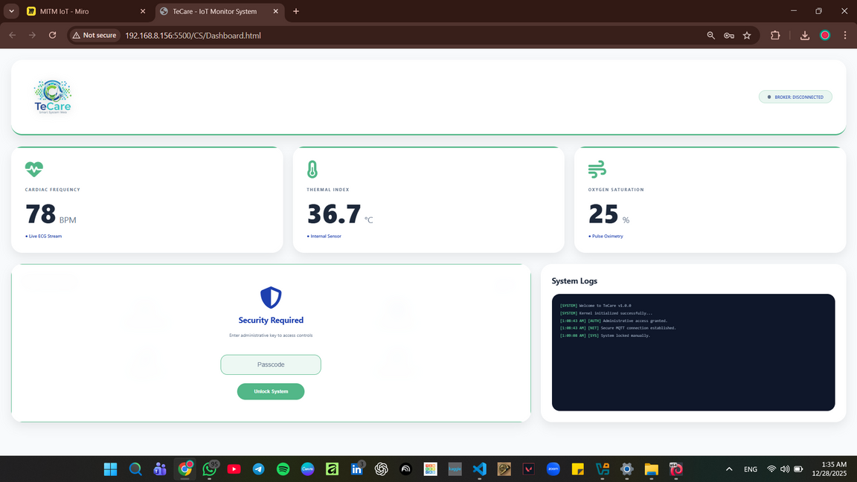
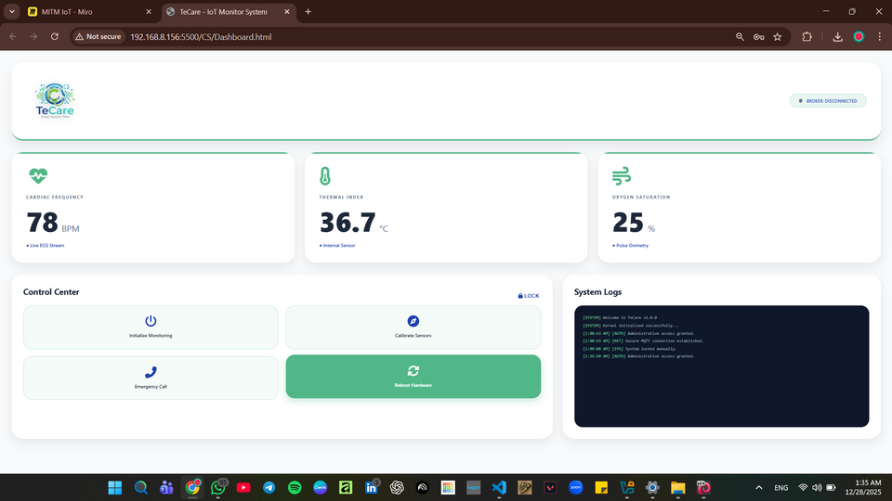
02
The Storm - Simulating the Attacks
Cracking the Control Center
Brute Force Attack
Vulnerability:
• Weak passcode protection in the IoT Monitor System control panel.
• No rate limiting or account lockout mechanism on the passcode input.
Execution:
• Using Burp Suite to automate multiple passcode attempts against the control interface.
• Sending repeated requests with different passcode values.
Result:
• Successful discovery of the correct control passcode.
• Gained unauthorized access to IoT system controls, allowing manipulation of device behavior.
• Highlights the risk of weak authentication mechanisms in IoT monitoring systems.

Slide 18

Dr. Ahmed :
You know... as much as those attacks were shocking, I am actually relieved. Now, the 'Invisible Threats' are finally visible. We are no longer guessing; we know exactly where our weaknesses are. But knowing the holes is only half the battle—now, I want to seal them. I want this hospital to be a 'Digital Fortress'. Team, show me the cure. Show me how
we will turn these vulnerabilities into
our strongest defenses.

Slide 19

03
The Shield - Defense & Design
Hello Dr.Ahmed
I’m ENG.Fatma
Security Infrastructure Engineer
"Dr. Ahmed, to build your 'Digital Fortress,' we started with the foundation: the Active Directory (AD). My role was to redesign the hospital’s hierarchy to ensure that access is a privilege, not a right

Slide 20
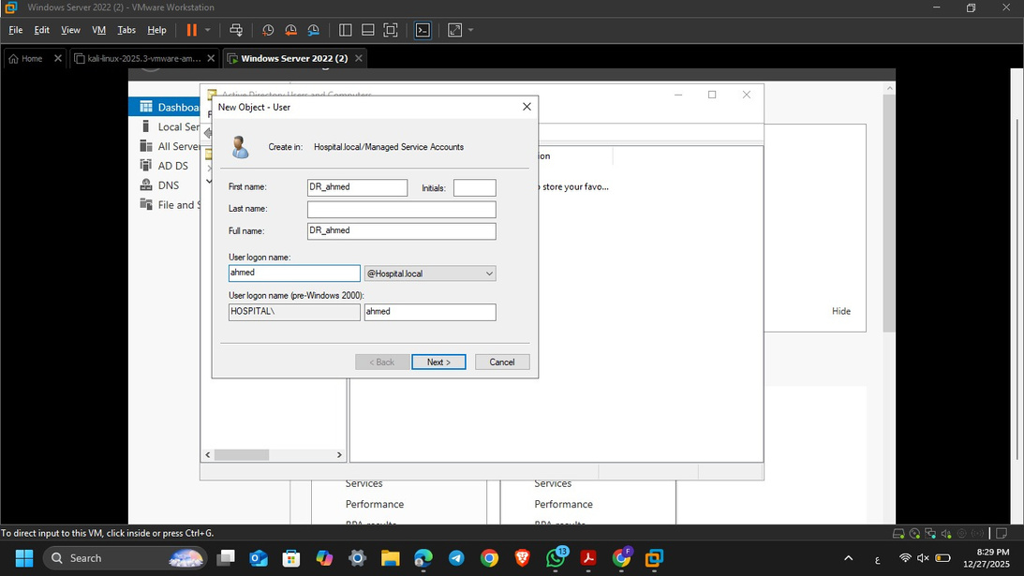
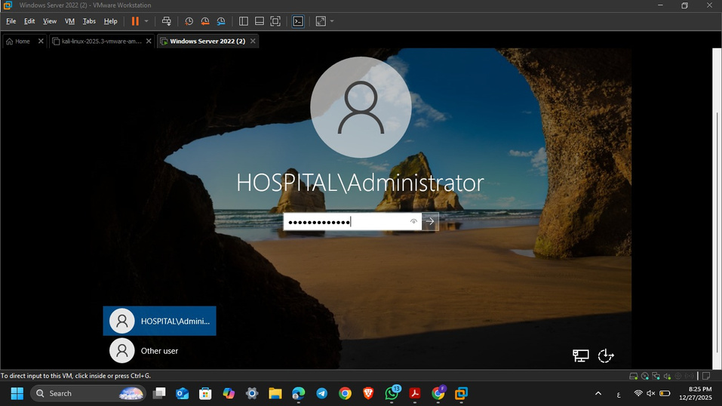
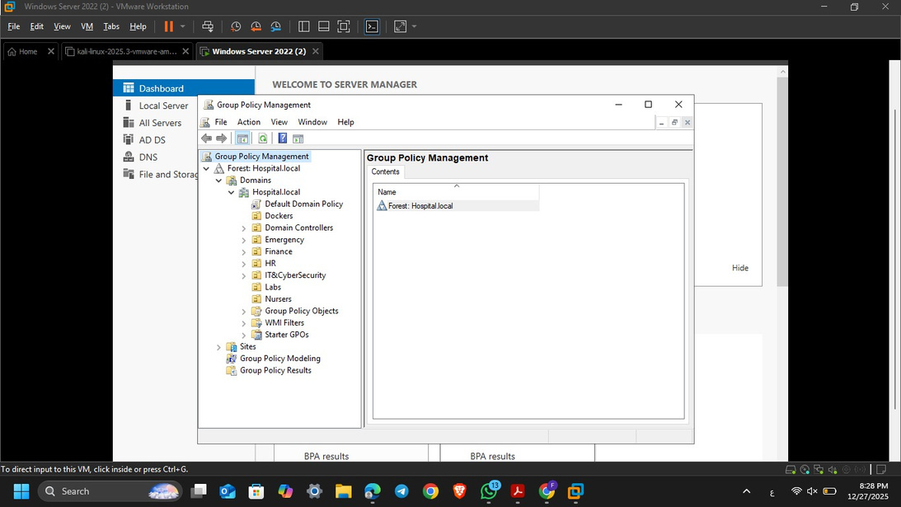
03
The Shield - Defense & Design
Identity & Access Management
(IAM) Strategy
Organizational Units (OUs):
Logical grouping of staff by department
Least Privilege:
Access is restricted to job-specific data only
Group Policy (GPOs):
Automated security rules (Strong Passwords & USB Blocking)
Centralized Control:
Instant, hospital-wide lockout of compromised accounts
Demo Link

Slide 21

Dr. Ahmed :
Excellent work, team! We started this journey with a 'Digital Kingdom' full of hidden cracks, but today, I see a Digital Fortress. You didn't just find the holes; you built the
shields. With the Active Directory
organizing our ranks and the SOC
watching our borders

Slide 22
I can finally say: Our hospital is ready, our patients are safe, and our future is secure. Let’s go live!

